Slide 1

Risk Analysis and Impact Analysis
Presented by Muskan

Slide 2

Risk Analysis
Risk Analysis is the process of identifying risks in applications and prioritizing them to test.
When a test plan has been created, risks involved in testing the product are to be taken into consideration along with the possibility of their occurrence and the damage they may cause along with solutions, A detailed study of this is called Risk Analysis.

Slide 3
Un Avoidable Risks
Some unavoidable risk might take place like:
Change in requirements or incomplete requirements
Time allocation for testing
Developers were delaying to deliver the build for testing
Urgency from a client for delivery
Defect Leakage due to application size or complexity

Slide 4
To overcome these risks, these activities can be done by
.
Conducting a Risk Assessment review meeting with the development team.
Creating Profile for Risk coverage that mentioning the importance of each area.
Creating Risk assessment database for future maintenance and management review.
Identify and describe the risk magnitude indicators: High, Medium and Low.

Slide 5
Impact Analysis
Impact Analysis is defined as analyzing the impact of changes in the deployed product or application.
The impact is analyzed on Requirements, Design & Architecture, impact on Test and on schedule.
The impact analysis will assure what part of an application need to be changed.

Slide 6
Sample Questions to be addressed for performing Impact Analysis
What are the adverse side effects or risks of making the proposed change?
Does any tool be acquired in order to implement the change?
If the change is accepted how much effort will be lost that is already been invested?
Does proposed changes adversely affect performance requirements?
Does the change increase the product cost?

Slide 7
Best practices for change Impact Analysis
Continue communication between developer and tester is must, not to miss any change needed to implement in the final product
Identify if any user interface changes, deletions or additions are required.
Identify if any user interface changes, deletions or additions are required.
Estimate the number of acceptance, system or integration test cases that will be required.

Slide 8
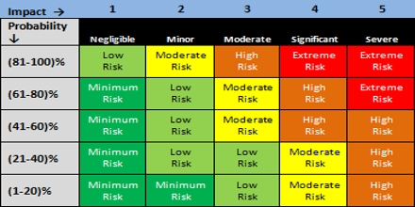
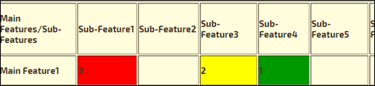
Risk and Impact Analysis

Slide 9

Thank you

